Slide 1
Computer Networks
Part 1
Notes:
[Sources]
- Πρότυπο: A.5.M1 Εισαγωγή.pptx
[/Sources]

Slide 2

What Is a Network?
A.5.M1 | Theory | Part 1
Definition
A computer network is a group of two or more computers or other devices connected to one another.
Data Exchange
Devices send and receive information through the network.
Sharing
A network allows users to share files, software, printers and an Internet connection.
Notes:
[Sources]
- Σημειώσεις Πληροφορικής Α΄ Λυκείου, Α5.1 Εισαγωγή στα Δίκτυα, σελ. 97–105
- Τετράδιο Εργασιών Πληροφορικής Α΄ Λυκείου, Φύλλο Εργασίας A.5.M1, σελ. 81–83
[/Sources]

Slide 3
LAN and WAN
A.5.M1 | Theory | Part 1
Local Area Network (LAN)
It covers a limited geographical area, such as a room, a building or nearby buildings.
Wide Area Network (WAN)
It connects several local networks and can cover cities or countries.
Internet
The Internet is the largest WAN. It connects the networks of organisations, schools, companies and homes.
Notes:
[Sources]
- Σημειώσεις Πληροφορικής Α΄ Λυκείου, Α5.1 Εισαγωγή στα Δίκτυα, σελ. 97–105
- Τετράδιο Εργασιών Πληροφορικής Α΄ Λυκείου, Φύλλο Εργασίας A.5.M1, σελ. 81–83
[/Sources]

Slide 4


Network Interface Cards
A.5.M1 | Theory | Part 1
Network Interface Card (NIC)
It connects a computer or another device to the network.
Wired Network Card
It uses a network cable and an RJ45 port.
Wireless Network Card
It uses radio waves and an antenna to connect to a Wi-Fi network.
Notes:
[Sources]
- Σημειώσεις Πληροφορικής Α΄ Λυκείου, Α5.1 Εισαγωγή στα Δίκτυα, σελ. 97–105
- Τετράδιο Εργασιών Πληροφορικής Α΄ Λυκείου, Φύλλο Εργασίας A.5.M1, σελ. 81–83
[/Sources]

Slide 5

Switch and Access Point
A.5.M1 | Theory | Part 1
Switch
A switch has several ports and connects wired devices to the same local network.
Access Point
An access point connects wireless devices to the local network.
Mixed Networks
A network can include a switch and an access point, depending on how each device connects.
Notes:
[Sources]
- Σημειώσεις Πληροφορικής Α΄ Λυκείου, Α5.1 Εισαγωγή στα Δίκτυα, σελ. 97–105
- Τετράδιο Εργασιών Πληροφορικής Α΄ Λυκείου, Φύλλο Εργασίας A.5.M1, σελ. 81–83
[/Sources]

Slide 6
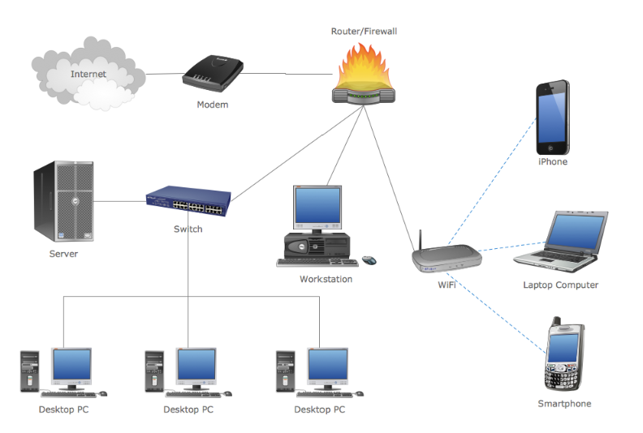
Router / Modem
A.5.M1 | Theory | Part 1
Modem
A modem converts the signal into the form required by the connection to the service provider.
Router
A router connects different networks and forwards data in the correct direction.
Home Network Device
At home, the router, switch, access point and modem are often combined in one device.
Notes:
[Sources]
- Σημειώσεις Πληροφορικής Α΄ Λυκείου, Α5.1 Εισαγωγή στα Δίκτυα, σελ. 97–105
- Τετράδιο Εργασιών Πληροφορικής Α΄ Λυκείου, Φύλλο Εργασίας A.5.M1, σελ. 81–83
[/Sources]

Slide 7
Data transfer Speeds
(bps, Kbps, Mbps και Gbps)
It’s the number of binary digits(bits) that are transferred from device to device per second - bits per second (bps, ή b/s).
It depends on the device and the data transfer medium.

Slide 8
Data transfer speeds
(bps, Kbps, Mbps και Gbps)
Multiples of bps:
  1 Kbps ≈ 1.000 bps
  1 Mbps ≈ 1.000.000 bps
  1 Gbps ≈ 1.000.000.000 bps

Slide 9
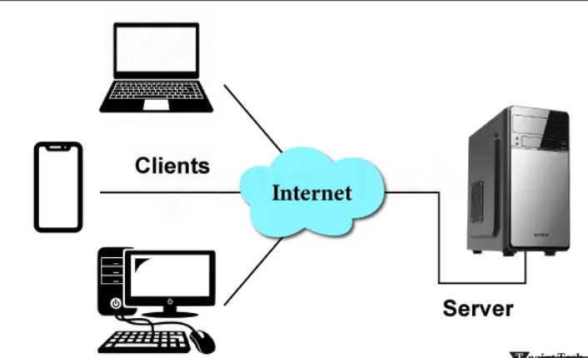
Client–Server
A.5.M1 | Theory | Part 1
Client
The user’s device or application requests access to a service.
Server
The server remains connected to the network and provides the service to many clients.
Example
A web browser acts as a client and requests a web page from the web server.
Notes:
[Sources]
- Σημειώσεις Πληροφορικής Α΄ Λυκείου, Α5.1 Εισαγωγή στα Δίκτυα, σελ. 97–105
- Τετράδιο Εργασιών Πληροφορικής Α΄ Λυκείου, Φύλλο Εργασίας A.5.M1, σελ. 81–83
[/Sources]

Slide 10
Reinforcement Activities
A.5.M1 | Part 1
1
True or False statements about networks, network categories, equipment, sharing and the client-server model.
2
Give examples of devices other than computers that can connect to a network.
3
Identify the network devices and connection media shown in the images.
Notes:
[Sources]
- Σημειώσεις Πληροφορικής Α΄ Λυκείου, Α5.1 Εισαγωγή στα Δίκτυα, σελ. 97–105
- Τετράδιο Εργασιών Πληροφορικής Α΄ Λυκείου, Φύλλο Εργασίας A.5.M1, σελ. 81–83
[/Sources]

